Slide 1
Linear/OLS Regression

Slide 2
What is Regression?
A way of explaining the value of one variable from another.
Linear, straight-line relationship
Fits the line through the correlation/scatterplot
Notes:
Equation is in form of straight line

Slide 3
Ordinary Least Squares

Slide 4
Describing a Straight Line
b₁
Regression coefficient for the predictor
Slope of the regression line
Direction/Strength of Relationship
b₀ (a)
Intercept (value of Y when X = 0)
Point at which the regression line crosses the Y-axis
Notes:
Yhat = a + bX + e (e, epsilon is error… everything else that can possibly explain value of Y)
Plug in values (slope)
B1 refers to increase or decrease in Y expected for every 1-unit change in X

Slide 5
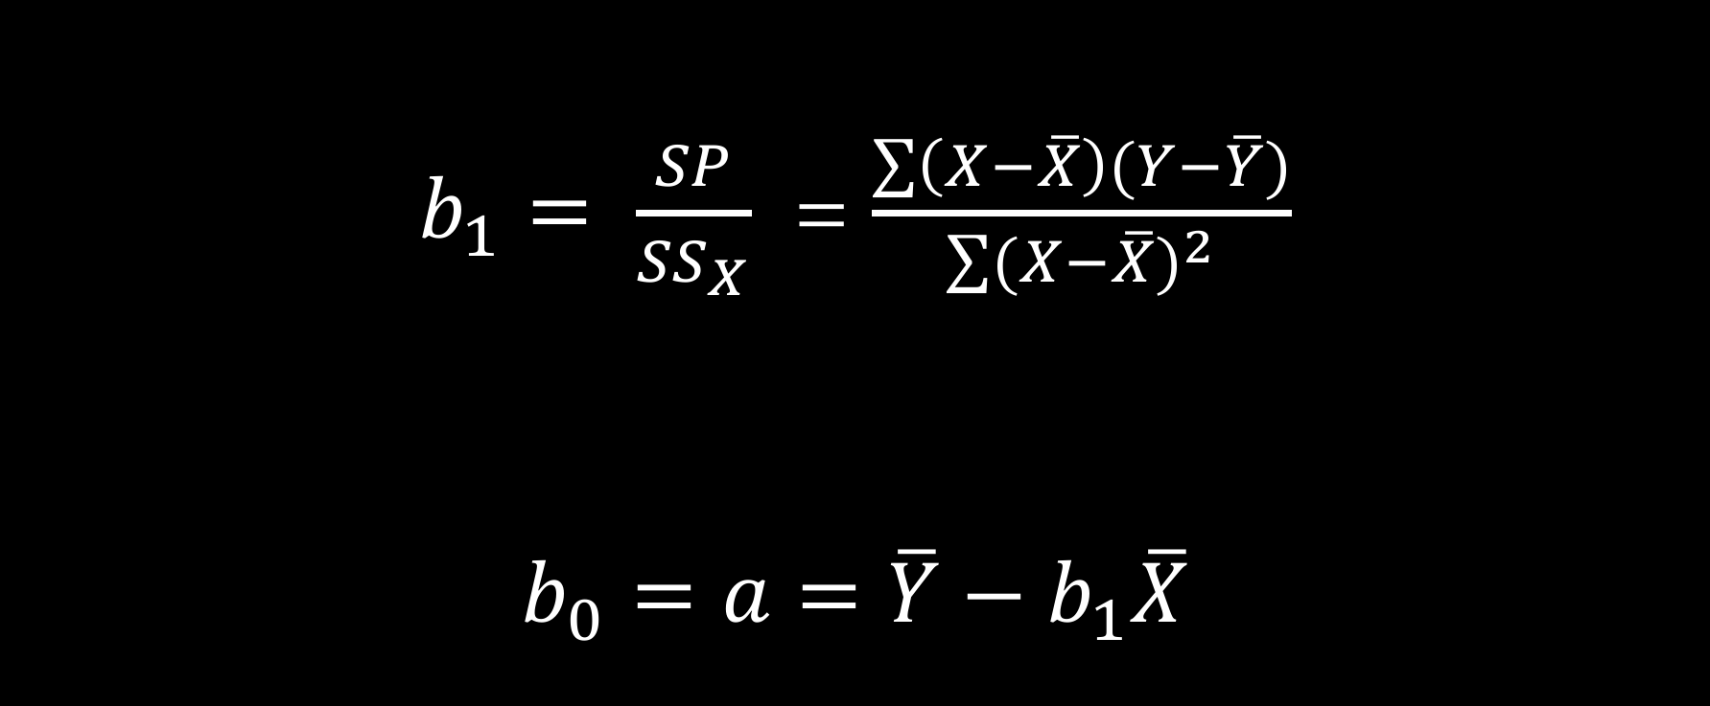
Calculating the Straight Line
$b_{1}= \frac{SP}{{SS}_{X}}$ = $\frac{\sum{\left(X−\overline{X}\right)(Y−\overline{Y})}}{\sum{{(X−\overline{X})}^{2}}}$
$b_{0}=a=\overline{Y}−b_{1}\overline{X}$

Slide 6
How Good is the Model?

Slide 7
Testing the Model Fit: ANOVA
SS_{T} = SS_{Y}
Total Variance In The Data
SS_{M}
SS_{R}
Improvement due to the Model
Error in Model
If the model results in better prediction than using the mean, then we expect SS_{M} to be much greater than SS_{R}
Notes:
SSM = SP^2
SST = SSx*SSy

Slide 8
Testing the Model Fit: ANOVA
SS_{T} = SS_{Y}
Total variability (variability between scores and the mean).
SS_{R}
Residual/Error variability (variability between the regression model and the actual data).
SS_{M}
Model variability (difference in variability between the model and the mean).

Slide 9
Testing the Model Fit: ANOVA

Slide 10
Testing the Model Fit: ANOVA
Mean Squares
Sums of Squares are total values, so can be averaged by df.
It tells us whether using the regression model is significantly better at predicting values of the outcome than using the mean
Notes:
MSm = SSm (SS regression model)/ df
MSr = SSr (SS error/residual) / df
It tells us whether using the regression model is significantly better at predicting values of the outcome than using the mean

Slide 11
How Much Variance in Y does Model Explain: R²
R²
The proportion of variance accounted for by the regression model.
The Pearson Correlation Coefficient Squared
Notes:
== SP^2 / SSx*SSy

Slide 12
An Example
A record company boss was interested in predicting album sales from advertising.
Data
200 different album releases
Outcome variable:
Sales (CDs and Downloads) in the week after release
Predictor variable:
The amount (in pounds) spent promoting the album before release.

Slide 13
Graph the Data

Slide 14
Regression Using IBM SPSS

Slide 15
Output: Model Summary

Slide 16
Output: ANOVA

Slide 17
SPSS Output: Model Parameters

Slide 18
Plug Values into Regression Equation

Slide 19
Reporting Regression
Model Fit Statistics and Variance Explained
R² = R²-value; R²-percent percent of variance in Y is explained X/the variables
ANOVA results indicate that overall model significantly/did not significantly explained Y, F(df_{regression}, df_{residual}) = F-value, p-value
Each Predictor/IV’s b, if significant, and the direction of the relationship
X₁ was significantly/not significantly related to the Y; every one-unit increase in X₁ was associated with a b₁-unit increase/decrease in Y (b₁ = b₁-value, t(N-1) = t-value, p-value).
The model yielded R² = .335; indicating that 33.5 percent of the variance in album sale revenue can be explained by the variance in advertising budget. ANOVA results indicate that the overall model significantly predicted album sale revenue, F(1,198) = 99.587, p < .001. Advertising budget was significantly related to the outcome; every one-unit (pounds) increase in budget was associated with a .096 unit (pounds) increase in album sale revenue (b = .096, t(199) = 9.979, p < .001).

Slide 20
ICE# 6
Number of Prior Convictions (x) | Sentence Length in Months (y)
0 | 12
3 | 13
1 | 15
0 | 19
6 | 26
5 | 27
3 | 29
4 | 31
10 | 40
8 | 48

Slide 21
Linear/OLS Assumptions
Y or Outcome or DV must be continuous
Relationship between IVs and DVs is linear
All observations are independent
Normality of distribution of variables

Slide 22
Standardizing Coefficients, Model Approaches, More Assumptions, And Multiple Regression

Slide 23
The More Tricky Assumptions
No Multicollinearity:
Predictors must not be highly correlated.
Homoscedasticity:
For each value of the predictors the variance of the error term should be constant.
Independent Errors:
For any pair of observations, the error terms should be uncorrelated.
Normally-distributed Errors

Slide 24
Multicollinearity
Multicollinearity exists if predictors are highly correlated.
This assumption can be checked with collinearity diagnostics.

Slide 25
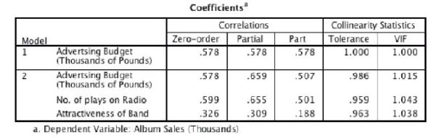
Tolerance should be more than 0.2 (Menard, 1995)
VIF should be less than 10 (Myers, 1990)

Slide 26
Checking Assumptions about Errors
Homoscedacity/Independence of Errors:
Plot ZRESID against ZPRED.
Normality of Errors:
Normal probability plot.

Slide 27
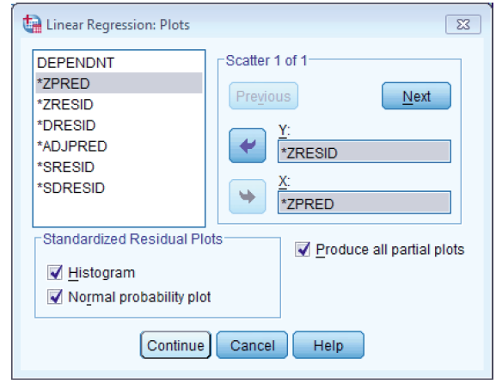
Regression Plots

Slide 28
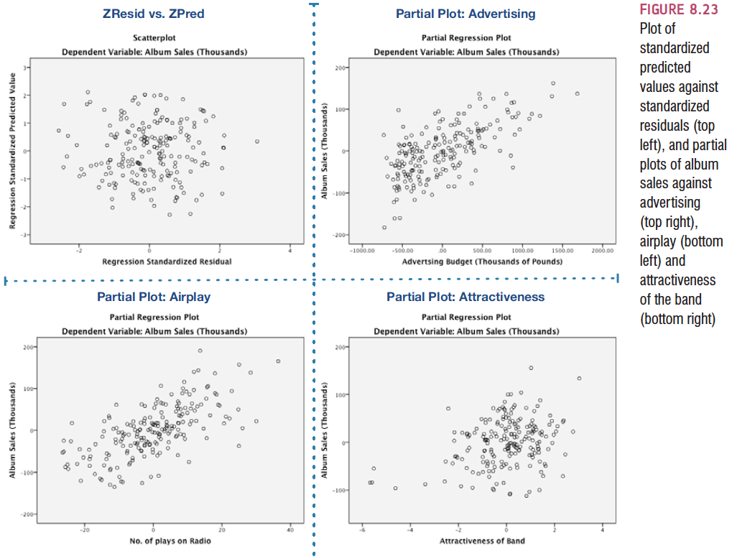
Homoscedasticity: ZRESID vs. ZPRED

Slide 29
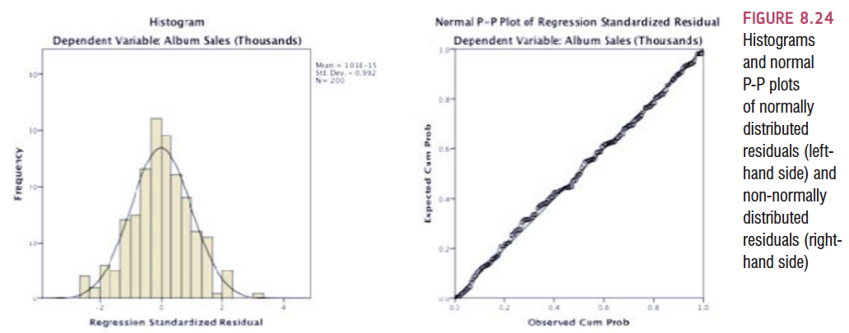
Normality of Errors: Histograms and P-P plots

